Slide 1

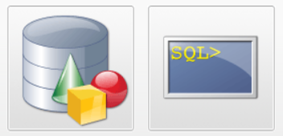
MKJ IT Learnings
The Corporate & Online Training Company
www.mkj-it-learnings.com
RDBMS
Storing Data into Database
Created By : Ashish Bansal

Slide 2
Session Outline
DDL (Data Definition Language) Commands
DML (Data Manipulation Language) Commands
Select Operations.
Inbuild Functions.
Stored Procedures
Triggers
PL-SQL

Slide 3
Relational Database
Data stored in rows and columns
Values are atomic
Columns are undistinguished and having unique names.
Data is in sequence.
Support SQL for quiring data.
Focused on Normalization (normalization is the process to store the data to avoid duplication and redundancy).
To minimize duplication of data.
To minimize or avoid data modification issues.

Slide 4
First Normal Form
First normal form focus on primary key
Each set of column must have unique value.
Each row should have a primary key .
Student Name | Course | Age
Ramesh | Java | 24
Ramesh | Salesforce | 24
Rakesh | Excel | 26
Lokesh | Spring Cloud | 31
Student Name | Course | Age
Ramesh | Java, Salesforce | 24
Rakesh | Excel | 26
Lokesh | Spring Cloud | 31
Notes:
1NF leads to duplication of data.

Slide 5
Second Normal Form-
Table should be in 1NF.
There should not be any partial dependency on Primary key.
Student Name | Age
Ramesh | 24
Rakesh | 26
Lokesh | 31
Student Name | Course
Ramesh | Java
Rakesh | Excel
Lokesh | Spring Cloud
Ramesh | Salesforce

Slide 6
Creation of Table
Create table is the command which includes , information of attributes along with data type and
constraints .
Constraints
Primary Key
Not Null
Unique
Foreign Key
Check Constraints. (used for better data validation purpose)
Default
Index

Slide 7
Syntax of Creation of Table
CREATE TABLE table_name ( column1 datatype constraint, column2 datatype constraint, column3 datatype constraint, .... );

Slide 8
Creation of Table
create table Instructor(
instructorCode int Primary Key,
name varchar(20) not null,
salary int not null,
jobStartYear int not null
);
1
Create Table InstructorInfo(
recordId int primary key,
instructorCode int references Instructor(instructorCode),
address varchar(100),
email varchar(30),
phone number(10),
firstLanguage varchar(20),
secondLanguage Varchar(20)
);
1

Slide 9
Continue…
create table Courses(
CourseName varchar(30) Primary Key,
Category varchar(30) not null,
Duration int default 30,
TestInclude int default 4
);
Create Table InstructorInfo(
……
);
Created in Last Step
N M
create table InstructorCourseInfo(
icInfoID int primary key,
CourseName varchar(30) references Courses(courseName),
instructorCode int references Instructor(instructorCode)
);
Note :- Go Through Student and Batch Table Creation Script in Script File.

Slide 10
Alter Table and Drop Table
ALTER TABLE "table_name" ADD "column_name" "Data Type";

Slide 11
CURD Operations
INSERT INTO "table_name" ("column1", "column2", ...) VALUES ("value1", "value2", ...);
UPDATE "table_name" SET "column_1" = [new value] WHERE "condition";
Select statements
DELETE from "table_name" WHERE "condition";

Slide 12
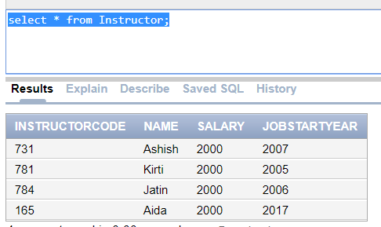
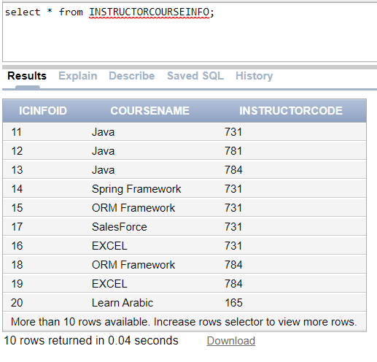
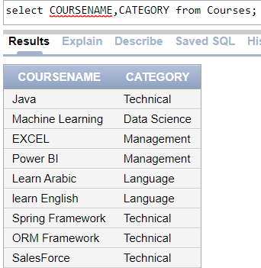
Insert Query

Slide 13
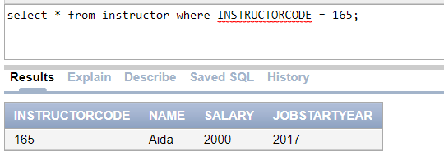
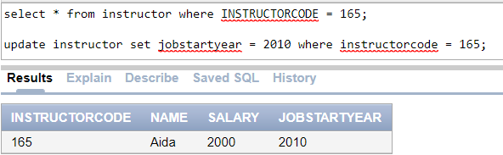
Update Query
update instructor set jobstartyear = 2010 where instructorcode = 165;

Slide 14
Select Statements
Where
In
Not In
Between
AND & OR
LIKE
ORDER BY
GROUP BY
HAVING
UNIQUE
SQL Functions
Average
Count
MAX
MIN
SUM
ROUND

Slide 15
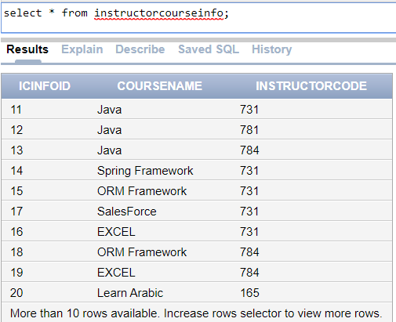
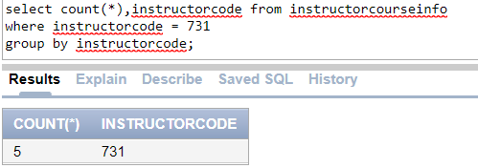
Select Statements – Group By
Objective : To find how many courses handled by trainer
number 731

Slide 16
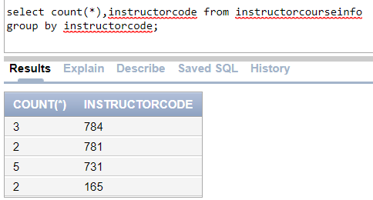
Select Statements – Group By Continue…
Objective : How many courses handled by trainers
Self Work : Change column name count(*) to
Number_Of_Courses
Hint : learn ‘as’ constraint

Slide 17
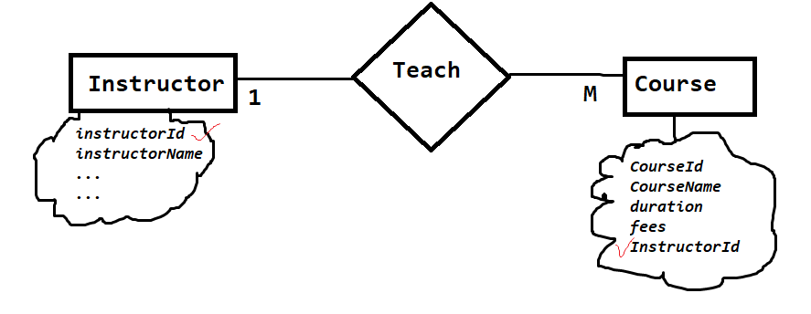
Joins
A relational database consists of multiple related tables linking together using common columns, which are known as foreign key columns. Because of this, data in each table is incomplete from the business perspective.
To get complete information, we have to query data from both Instructor & Course tables.
A join is a method of linking data between one or more tables based on values of the common column between the tables.
Notes:
https://www.mysqltutorial.org/mysql-join/

Slide 18
Terminology
What is Left and Right Table ?
Left Table : - The Table which used to make select statement.
Right Table :- The Table which used for joining left table

Slide 19
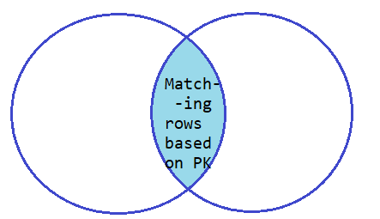
Where to Use Inner Join
It produces the data set that includes rows from the left join which have matching rows from the right tables
Select * from Employee
Inner Join EmployeeDetails ON
Employee.empID = EmployeeDetails.empID

Slide 20
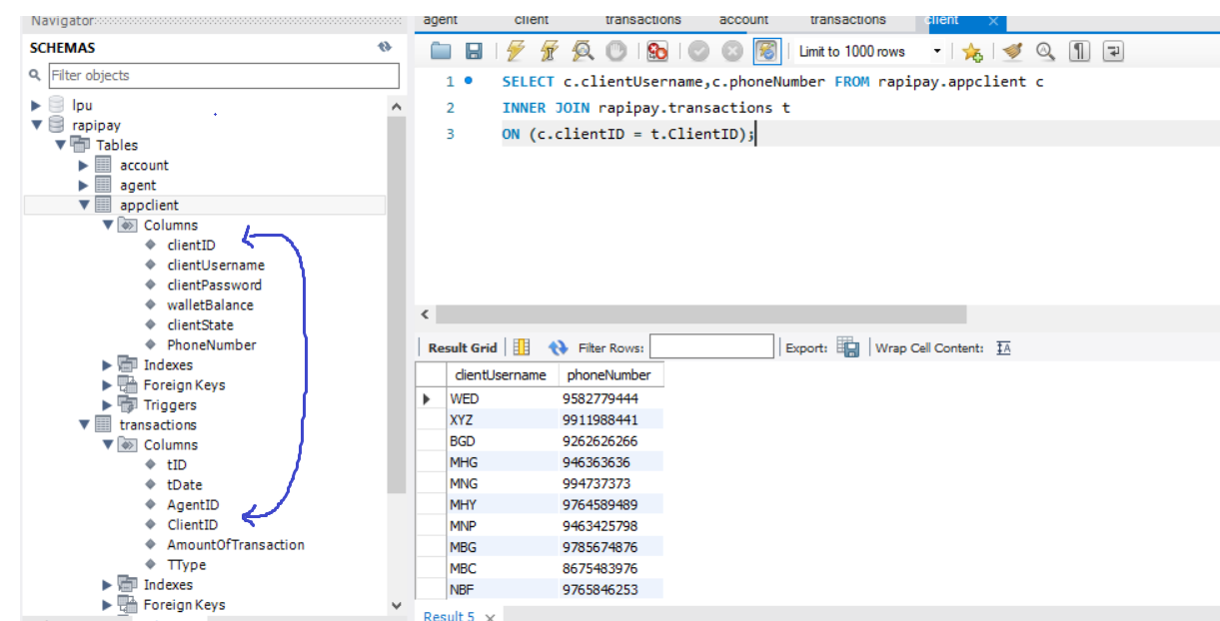
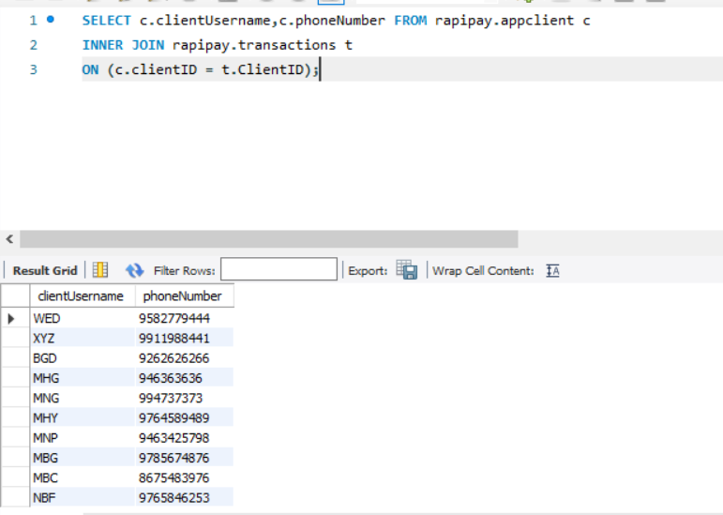
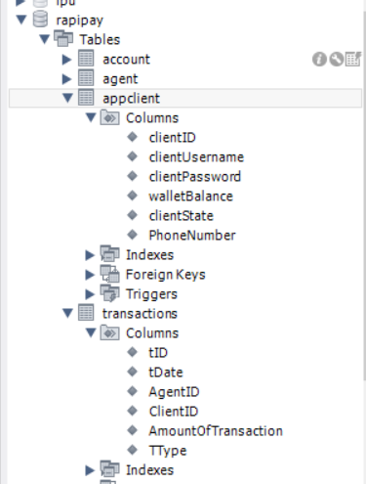
Inner Join
Notes:
It will not include the data which is not common in both table

Slide 21
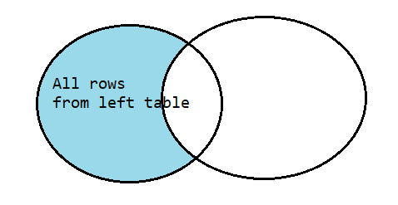
Left Join
Return all records from the left table , even if there are no records matches in the right table.
For unmatched values in the right tables null is displayed.

Slide 22
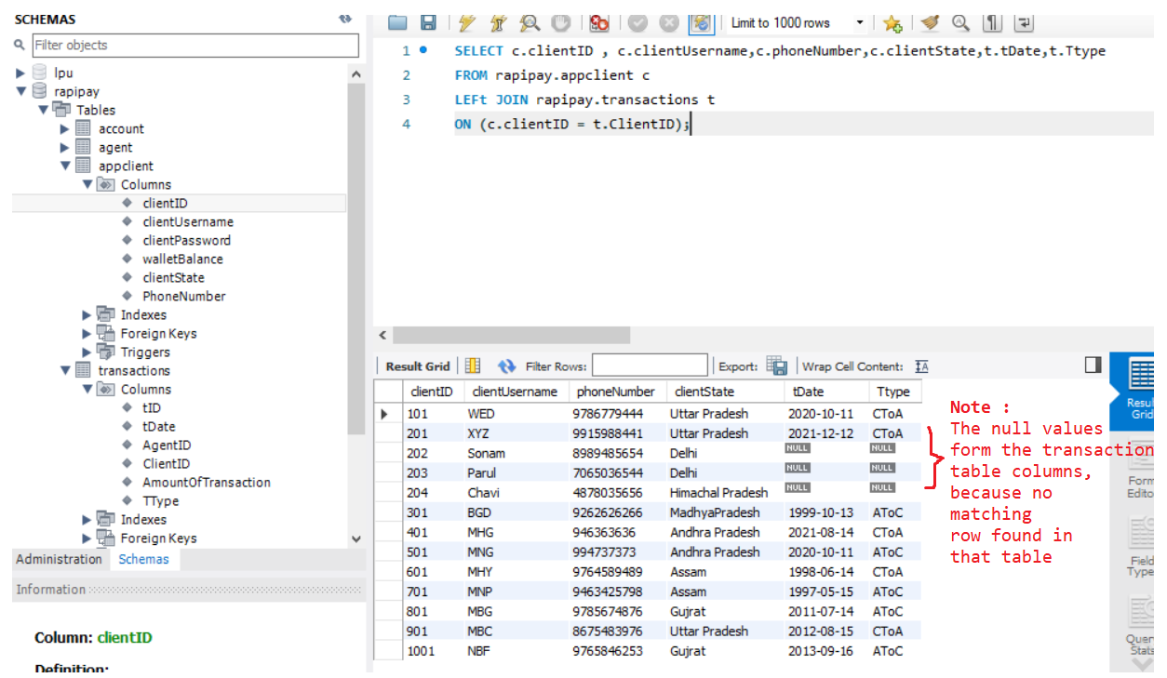
Left Join
Notes:
Right join exactly the reverse of the left join

Slide 23
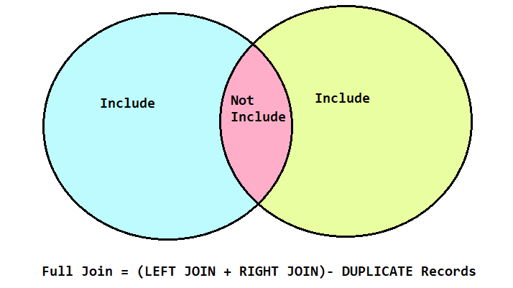
SQL Full Join

Slide 24
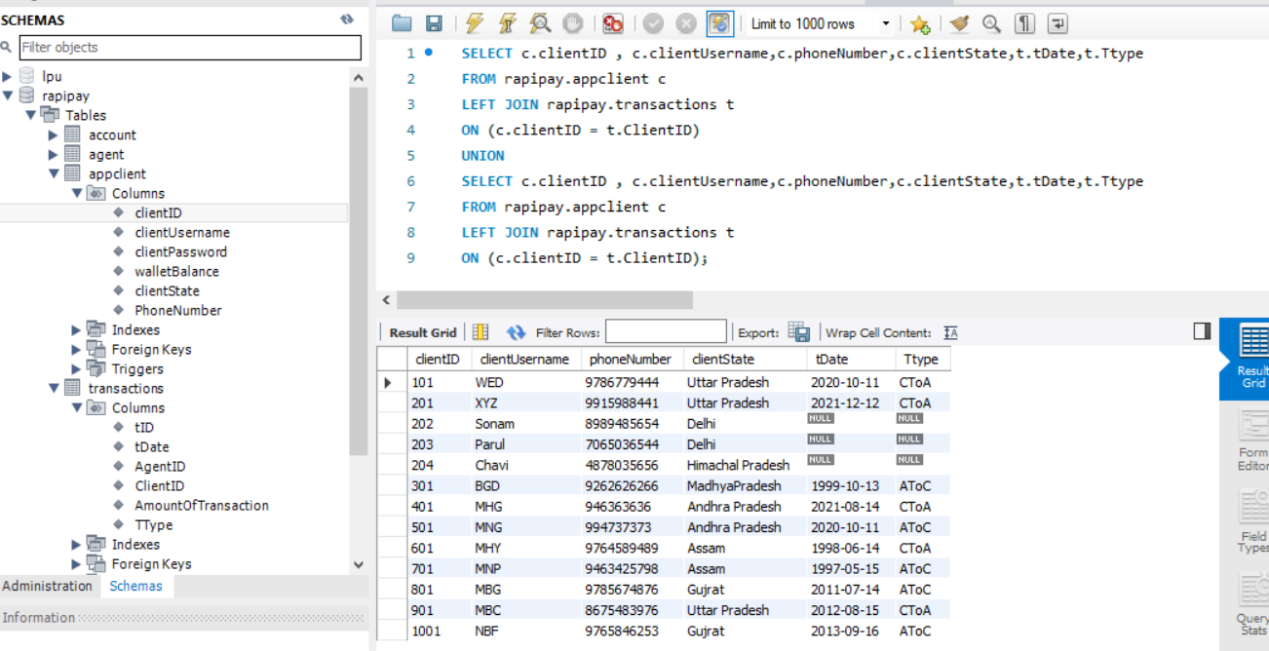
SQL Full Join (Union Clause in MYSQL)

Slide 25
Cross Join
Every record of left table associate with right table
No need of any common column between tables.

Slide 26
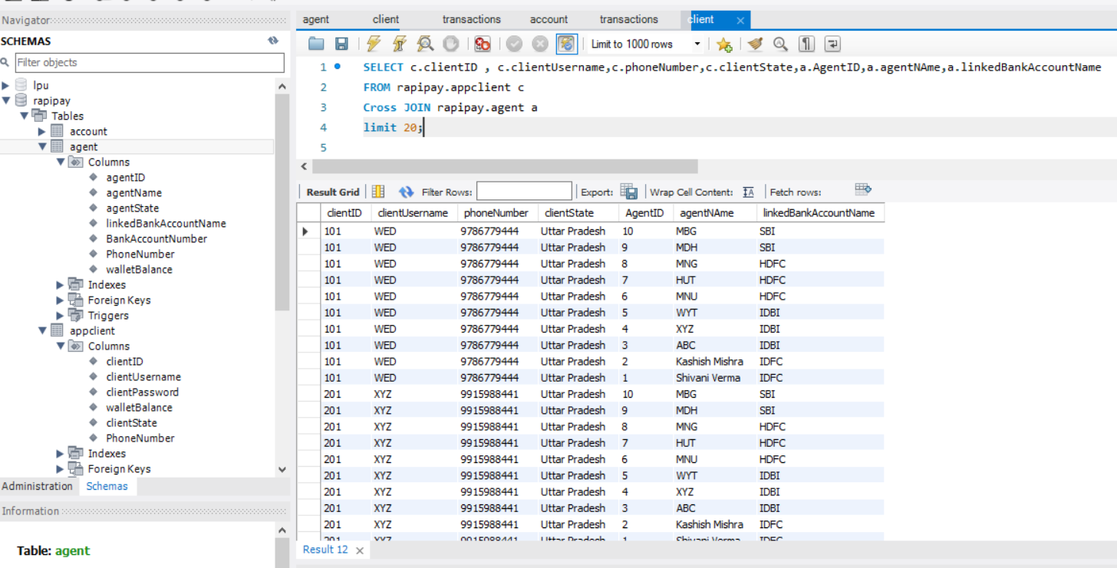
Cross Join

Slide 27
Stored Procedure
RDBMS databases has the feature called stored procedure, which is a set of SQL statements which can perform repetitive task. The stored procedure can be called using applications like Java ... or other stored procedures.
Stored procedure limits the user's direct access to data tables. It gives an interface and secure mechanism to manipulate data. With stored procedures, the repetition of code is avoided and the code block can be called whenever necessary. It allows variable declaration, parameter passing; return multiple values, flow statements.
Stored procedures are created using CREATE PROCEDURE
Notes:
http://www.brenkoweb.com/tutorials/mysql/mysql-stored-procedures
Stored procedures are compiled when on need. Once it is compiled, it is put in cache. Every connection has a stored procedure cache. If the stored procedure is used multiple times in single connection the cache is accessed else, it works as query. If there are a number of stored procedures, the memory usage for every single connection gets increased. This in turn increases CPU usage. It is difficult to debug stored procedures. Store procedures have advantages and disadvantages. So their usage is decided by business requirements.

Slide 28
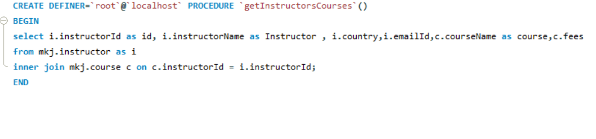
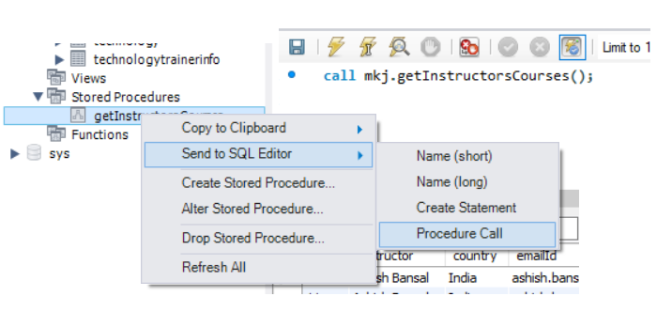
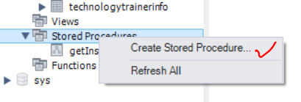
Stored Procedure- Creation & Calling
Notes:
http://www.brenkoweb.com/tutorials/mysql/mysql-stored-procedures
Stored procedures are compiled when on need. Once it is compiled, it is put in cache. Every connection has a stored procedure cache. If the stored procedure is used multiple times in single connection the cache is accessed else, it works as query. If there are a number of stored procedures, the memory usage for every single connection gets increased. This in turn increases CPU usage. It is difficult to debug stored procedures. Store procedures have advantages and disadvantages. So their usage is decided by business requirements.

Slide 29
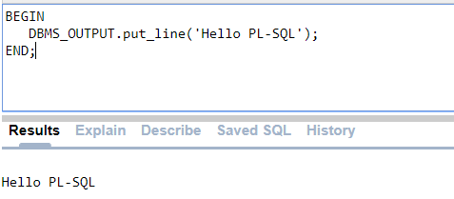
PL-SQL
Pl – SQL is the blocked programming language for Database.
Program units can be named or unnamed blocks.
Unnamed blocks are known to be as anonymous blocks because its not going to be saved in the database. So it will never have name.
We typically use such blocks whenever we need to perform one time activity.
BEGIN and END are the starting and ending of the block.
DBMS_OUTPUT is used to render output either on console or file system.

Slide 30
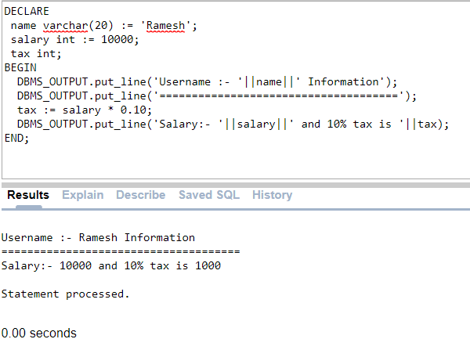
PL-SQL Continue..
Declare section is used to declare and initialize variables. All variables consider as local scope.
Assignment operator is :=
Concatenation operator is ||

Slide 31
PL-SQL Data Types
Basic Data Types
Varchar2 | Variable length character , max size 4000 & min size should be 1.
Number(p,s) | P stands for precision and s stands for scale. The precision p can range from 1 to 38, and scale can have range from 84 to 127.
Long | Character data variable upto 2GB.
DATE | Valid date
Many more data type and sub data types are available , like Integer which is a sub type of Number data type, which takes only whole number.

Slide 32
PL-SQL Type conversion
Type Conversion
If we want to convert the values to the different data type , we should use type conversion functions.
to_char(value,[format_mask]) | Use to convert number or date to String. Format_mask is optional use to provide format to the String
To_number(String , [format_mask]) | Use to convert String to number and format_mask is optional , which is use to provide formatting
To_date(String,[format_mask]) | Use to convert String to date and format_mask is optional , which is use to provide formatted date.

Slide 33
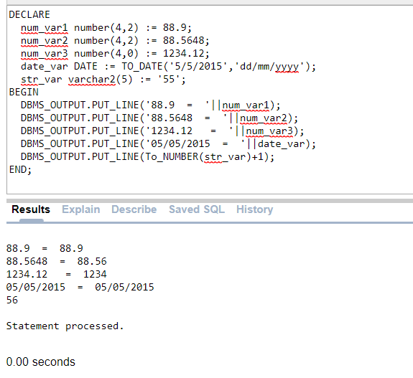
PL-SQL
Assigning any number more than 4 digits leads compile time error.
Assigning date in different format leads compile time error.

Slide 34
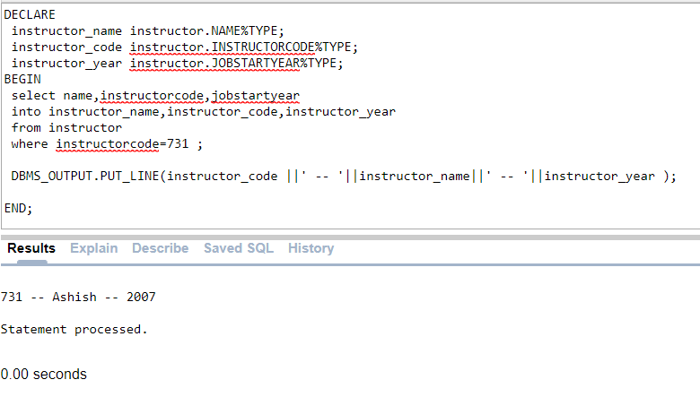
PL-SQL %TYPE & %ROWTYPE
%TYPE used to assign datatype of a column .
%ROWTYPE used to assigned entire row to the variable so that further value can be accessed easily.

Slide 35
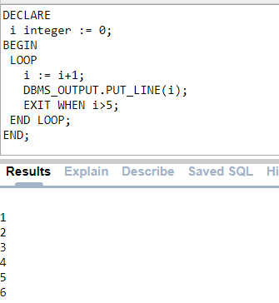
PL-SQL Control Statements
IF <Condition>
THEN
statements
statements
ELSE
statements
statements
END IF;
Note:
The PLSQL EXTRACT function is used for extracting a specific value such as year, month, day or hour from a date
Syntax :
EXTRACT (field from source)

Slide 36
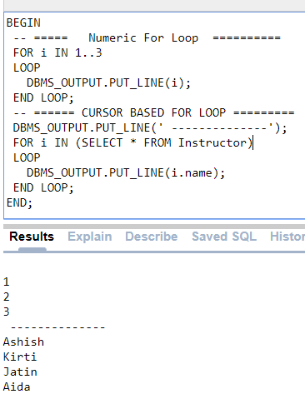
PL-SQL for loop
PL/SQL support two versions of for loop a) numeric and b) cursor FOR loop
The numeric for loop iterates across defined range.
While the cursor for loop iterates over returned select statements.
Syntax:
For i IN x..y
LOOP
statements
END LOOP;
For i IN (select statement)
LOOP
statements
END LOOP;

Slide 37
PL-SQL - Procedures
Stored Procedures are created to perform one or more DML operations on Database.
It is nothing but the group of SQL statements that accepts some input in the form of parameters and performs some task and may or may not returns a value.
Both function as well as stored procedure have a unique named block of code which is compiled and stored in the database.
The most important part is parameters. Parameters are used to pass values to the Procedure. There are 3 different types of parameters, they are as follows:
IN
OUT
IN OUT
IN | IN mode refers to READ ONLY mode which is used for a variable by which it will accept the value from the user. It is the default parameter mode.
OUT | OUT mode refers to WRITE ONLY mode which is used for a variable that will return the value to the user.
IN OUT | IN OUT mode refers to READ AND WRITE mode which is used for a variable that will either accept a value from the user or it will return the value to the user.

Slide 38



MKJ IT Learnings
Training for professionals

